Slide 1

efficient
faster
Instant Report
Reporting done right!
easier
Save Money!
Save Time!
Jewel
Kaush
Carlos
cloud
Smart
Real-time

Slide 2

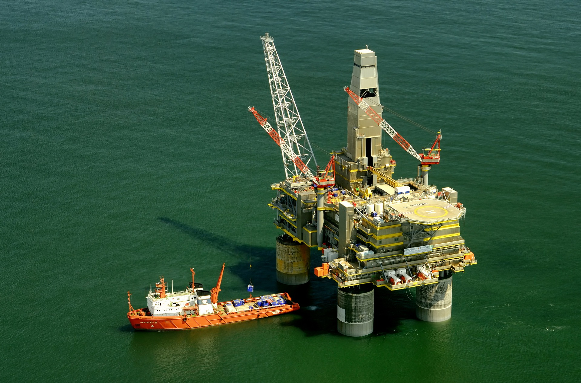

So you are working on a typical day, when suddenly

Slide 3

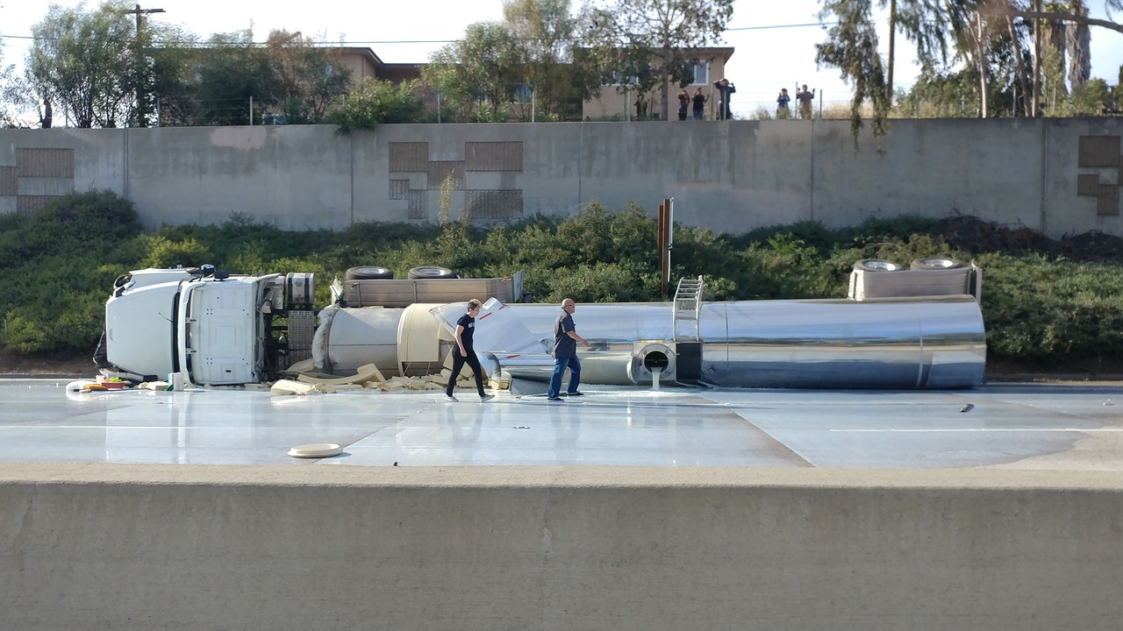



An incident occurs!

Slide 4

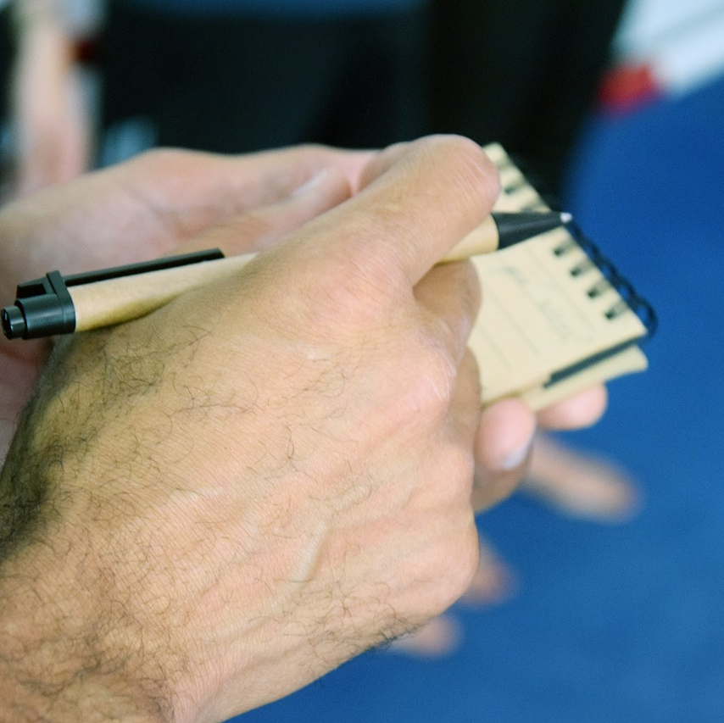

You do what you normally do
Take action
Communicate
Document
Notes:
Make calls
Take action
Record Information
Wait for approvals
Request resources

Slide 5
When the dust settles…
Take action
Communicate
Document
Notes:
Make calls
Take action
Record Information
Wait for approvals
Request resources

Slide 6




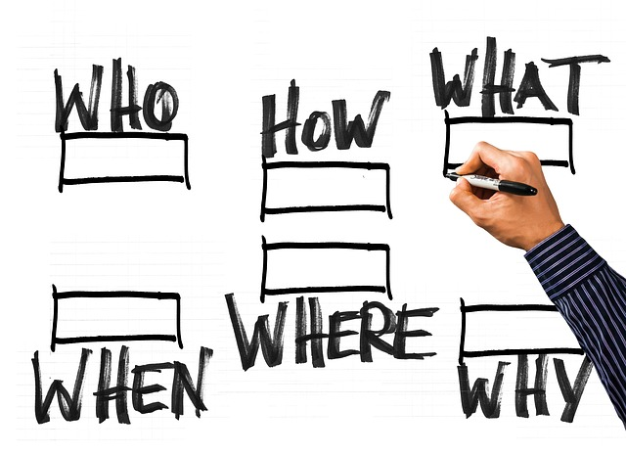

Grunt work begins…

Slide 7

Instant Report
Great…another incident reporting tool!
More work… Right?

Slide 8

Instant Report
NO
Great…another incident reporting tool
More paper work…

Slide 9
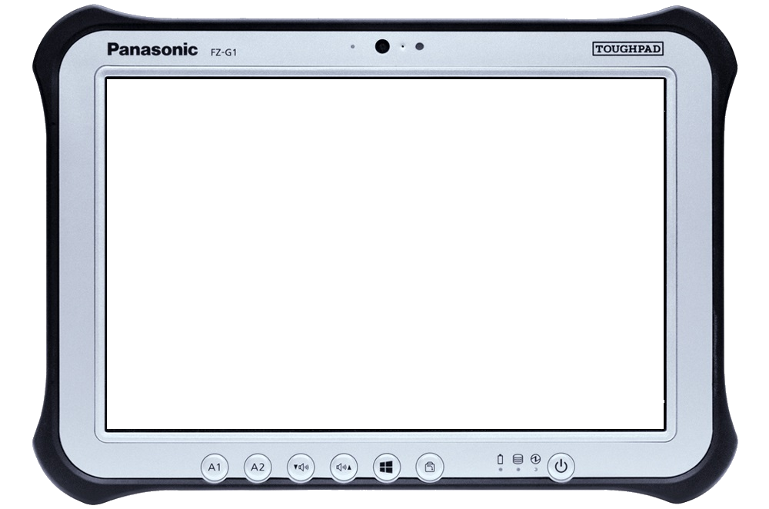
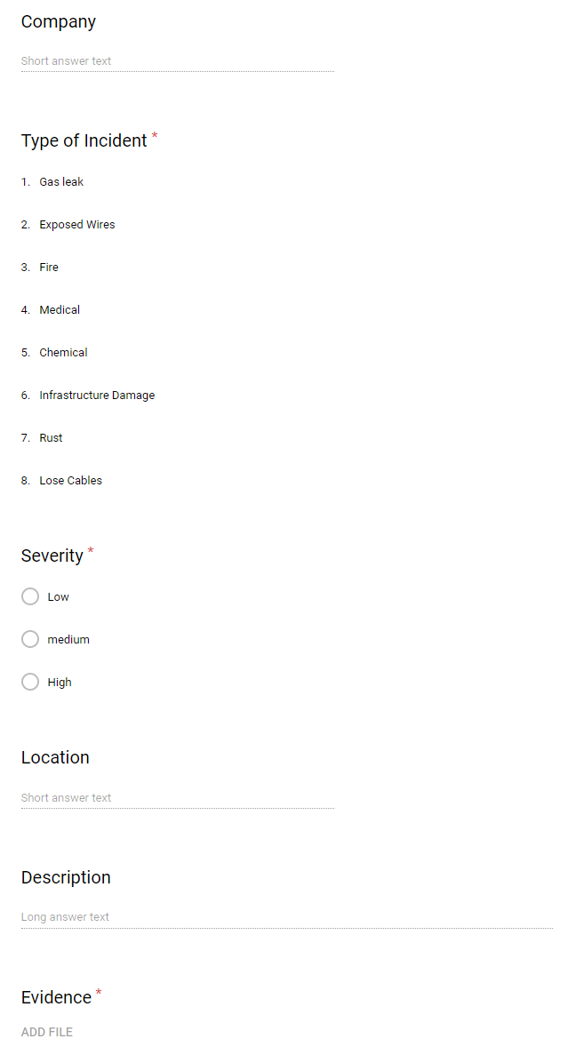



HOW are we different?
User reports incident on device (with evidence included)
Data is sent to the database
People higher up in the chain of command see it
Support Center
Management
On-site personnel

Slide 10
HOW are we different?
User reports incident on device (with evidence included)
Data is sent to the database
People higher up in the chain of command see it
From 2 hours
To
Under 2 minutes
Support Center
Management
On-site personnel

Slide 11






RESULTS
Offline and Online
Easy to use and Integrate
Reduced human error
CUSTOMIZABLE
No more paper
Wasted Time

Slide 12

“But I’m sure there’s gotta be plenty of other products in the market…”

Slide 13

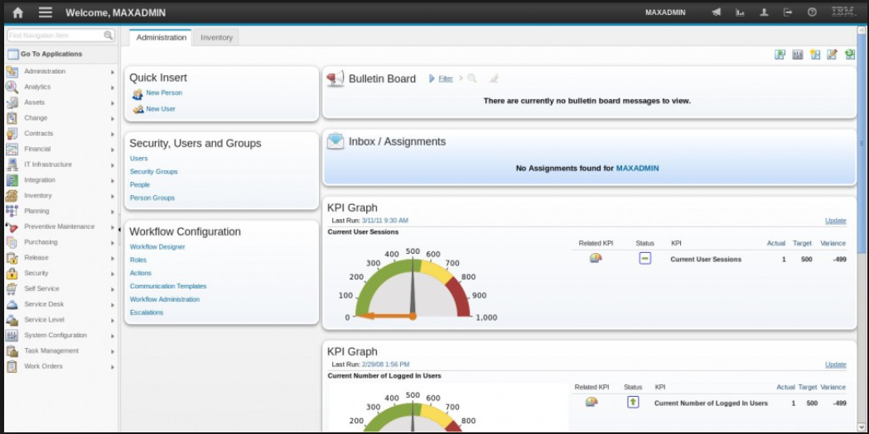
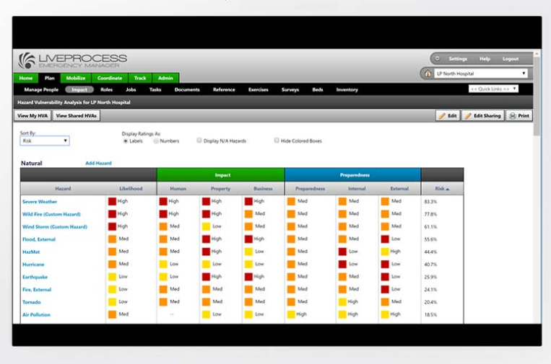
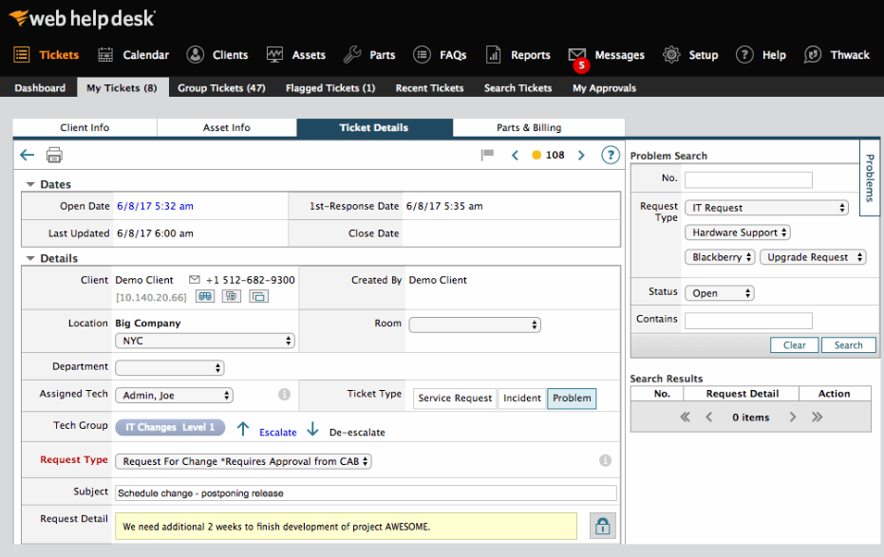
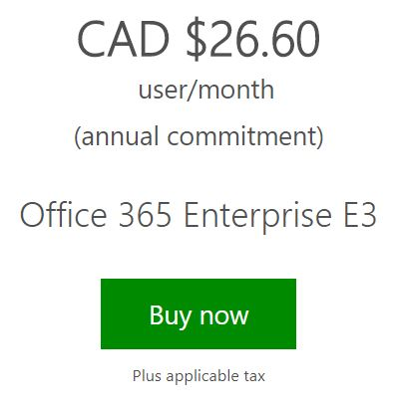


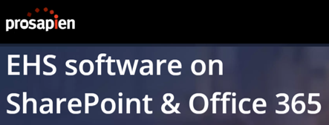

So what else is on the market?
Complex
Not Customizable
Monopoly
Proprietary software: Outdated and Hard to maintain/migrate

Slide 14
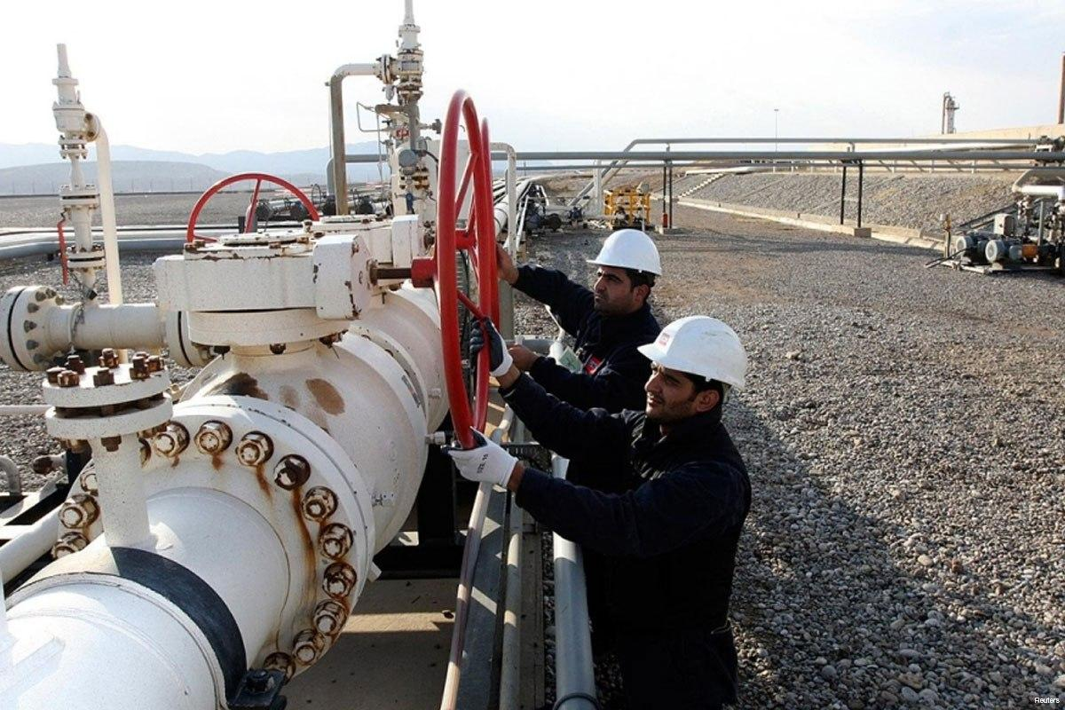
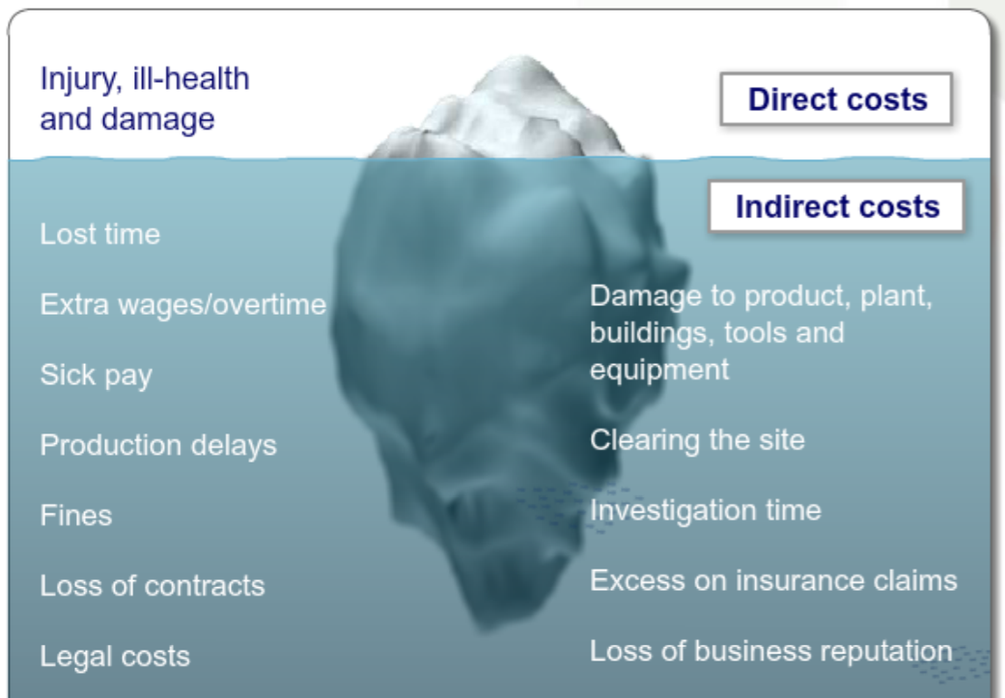
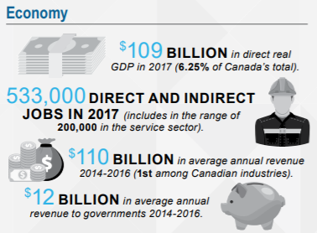
Something to think about…
Notes:
Avg. Salary for 1 person = $20
If you spend 1 hour/week documenting incidents….
$20 x 1 hour x 52 weeks =
$1000/year

Slide 15
Potential Markets
Oil & Gas
Mining
Construction
Healthcare
High risk
Remote

Slide 16
GO TO MARKET
Today
1 month
1 – 6 months
6 months to 1 year
+1 year
Phase 1: O&G Hackathon
MVP
Phase 2: Initial Investors
Onsite testing
Security Protocols
Auto-Error correction
System Integration
APIs for 3rd parties
Phase 3: Machine Learning
Data Analytics
Prediction Software
Pic to text
IoT- Integration with onsite sensors and available data
Phase 4: Expansion
Stronger marketing
Infrastructure upgrades
Robustness
Strategic Partners (NOIA for example)
Phase 5: Diversification
Apply existing products to other markets
Offline/Online capabilities
Cloud Based
Maintenance reports
Inspections
Inventory

Slide 17
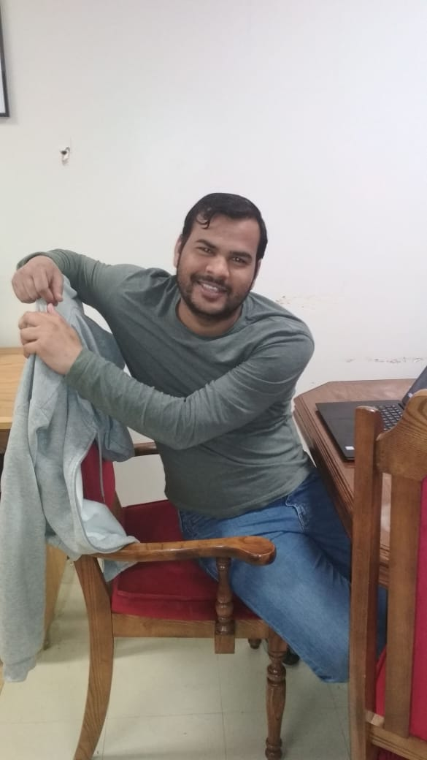
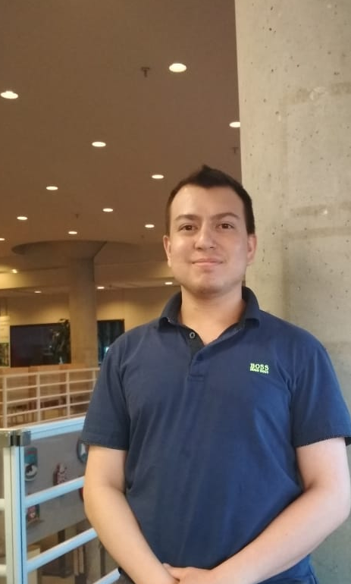
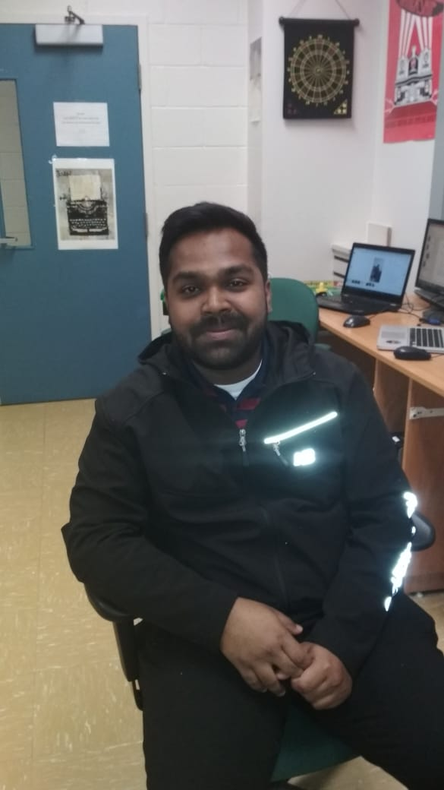
Who we are
The Brains
The Brawn
The looks

Slide 18



Slide 19

The DEMO
Notes:
Save time and money, explain the benefits
Tell them what the value of using your product
And services
You want people to buy in
Potential customers here!
The great 8
Pain
Solution
Competition
Revenue streams
Traction
Team
ask

Slide 20
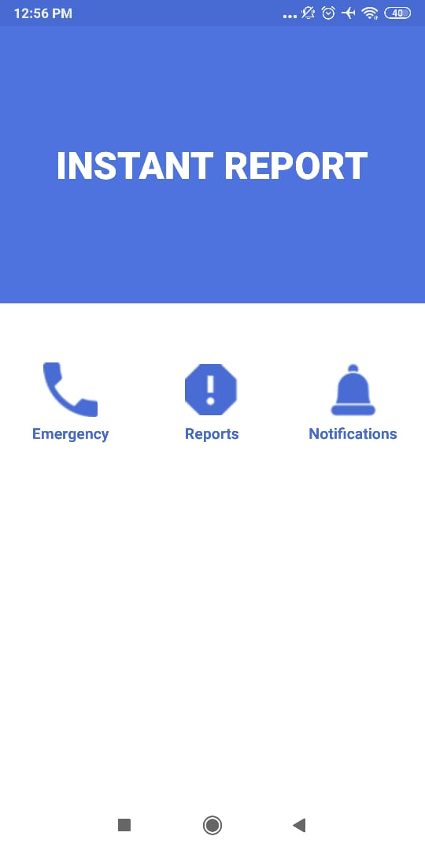
Contact us for more details
Carlos : cdsalcedo@mun.ca
Kaush : Kaushlenderk@mun.ca
Jewel : jmnshamin@mun.ca

